Slide 1
Influenza in California
Dapper Dawgs Pharmaceuticals Marketing Team
Joshua, Samir, Araz, Milton, and Karran

Slide 2
Marketing @ Dapper Dawgs Pharmaceuticals
WHO WE ARE
Task: Create a flu awareness and prevention campaign for the state of California
Focus: Analyze flu data for California between the years of 2014-2018
Notes:
These are my notes on this slide

Slide 3
TABLE OF CONTENTS
01
04
02
05
03
06
GOALS, LIMITATIONS, DATA SETS
MORTALITY
VACCINATION
RECOMMENDATIONS
FLU CONTRACTION
QUESTIONS
Notes:
-******Remove subtext from each section. Just keep the high level header*****

Slide 4
GOALS
01
02
03
When should we launch the flu vaccination awareness campaign?
Where should we target the campaign?
Which demographics should be our primary audience?

Slide 5
Data Sets
Vaccination Rates
via the Center for Disease Control (CDC)
Flu Contraction Rates
via California Health and Human Services Open Data Portal
Mortality Rates
via the Center for Disease Control (CDC)

Slide 6
DISCLAIMERS
1
3
Vaccination Data from CDC was collected via a phone survey
Not everyone picked up Self-survey
Contraction Data excluded data from labs that serviced both Upper and Lower Southern California. Only included labs that exclusively served one
2
4
Vaccination Data was collected early in flu season, so the true vaccination rate by the end of the season could’ve been higher
Many people (especially within ages 18-49) contract the flu but do not report it

Slide 7
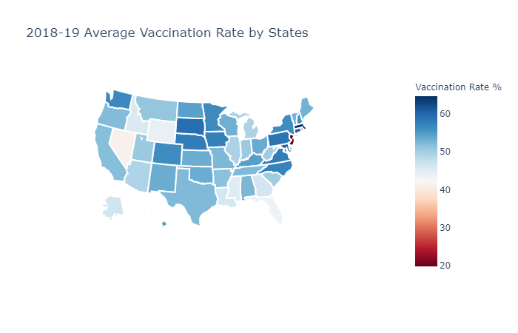
HEATMAP 2.0
California is... pretty average

Slide 8
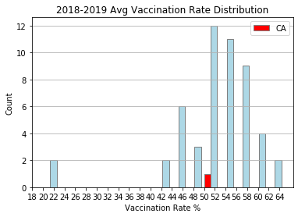
VACCINATION RATES
Most states are between 51%-55%
CA is a little below the average

Slide 9
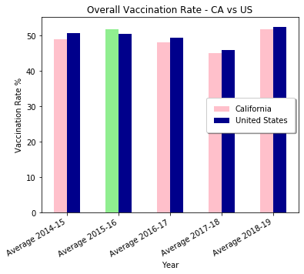
CA vs. USA
California usually performs worse than the national average

Slide 10
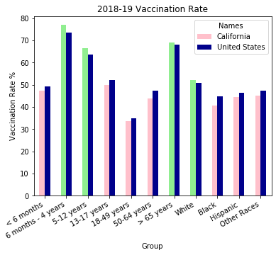
CA vs US
Young teens, elderly, and White people get vaccinated the most

Slide 11
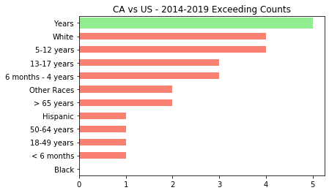
CA vs US
Young teens and white people take the most preventative measures

Slide 12
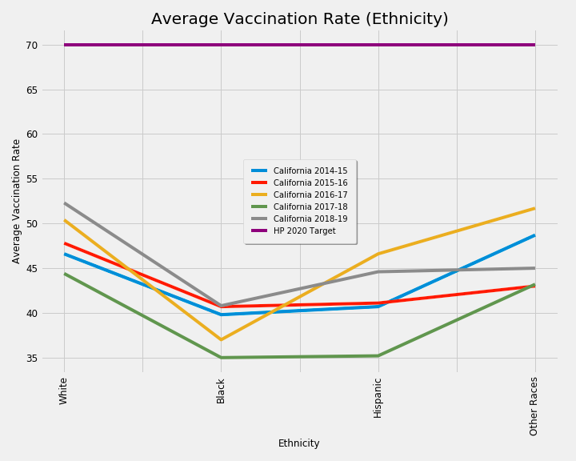
VACCINATION BY ETHNICITY
Healthy People 2020:
Preventative service organization that sets 10-year, national objectives for improving the health of all Americans
9

Slide 13
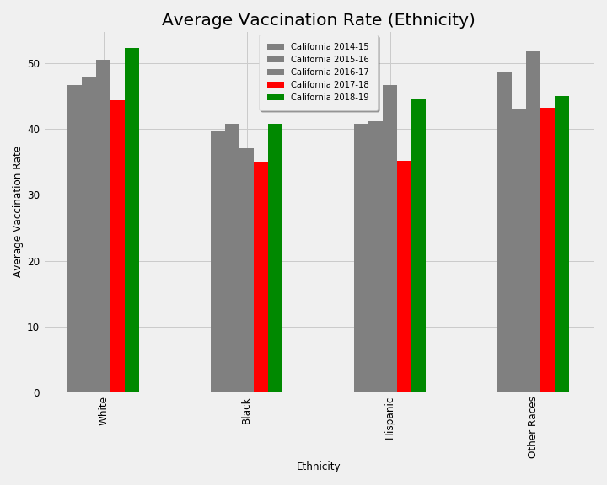
VACCINATION BY ETHNICITY
12

Slide 14
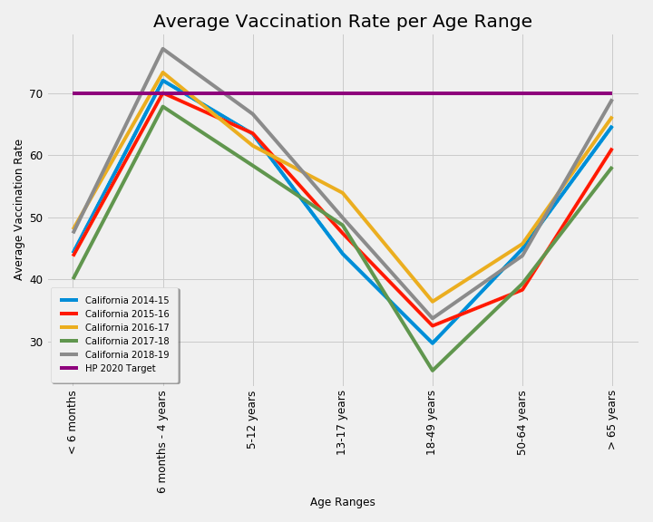
VACCINATION BY AGE

Slide 15
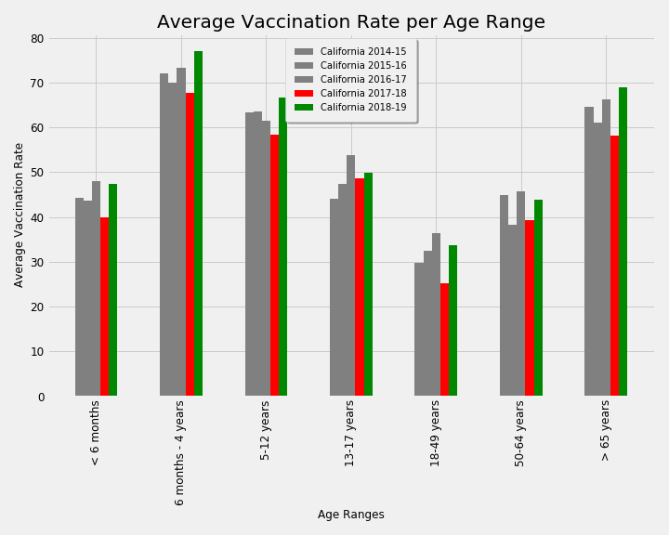
VACCINATION BY AGE
8

Slide 16
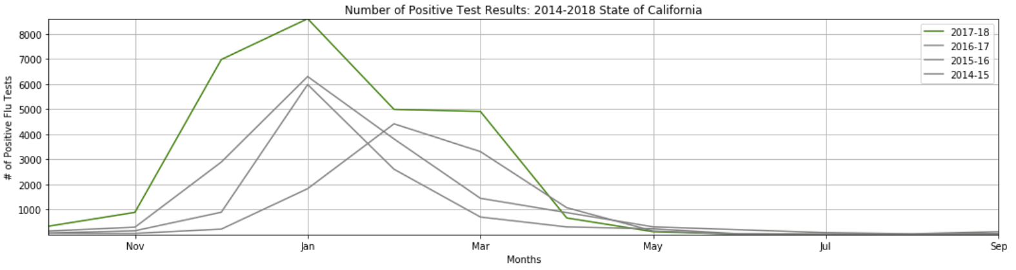
CONTRACTION: STATE & REGIONAL
Notes:
Morbidity data shows a connection between morbidity rates and vaccination rates,: Lower the vaccination rates then greater the morbidity rates.
For example, there was a large drop off of vaccination rates in California for the 2017-18 flu season. California experienced a significant increase in morbidity rates during the 2017-18 flu season compared to previous years

Slide 17
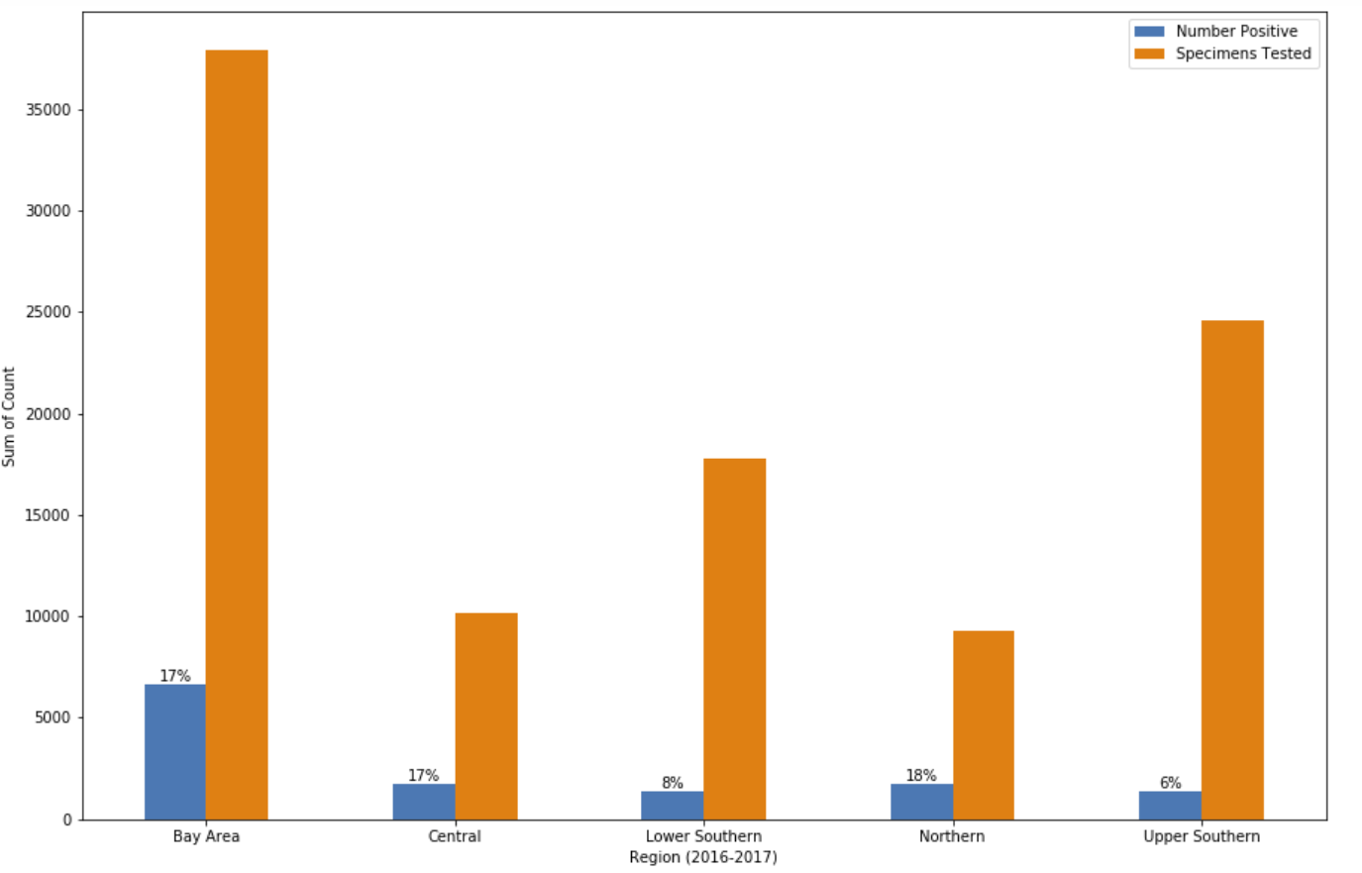
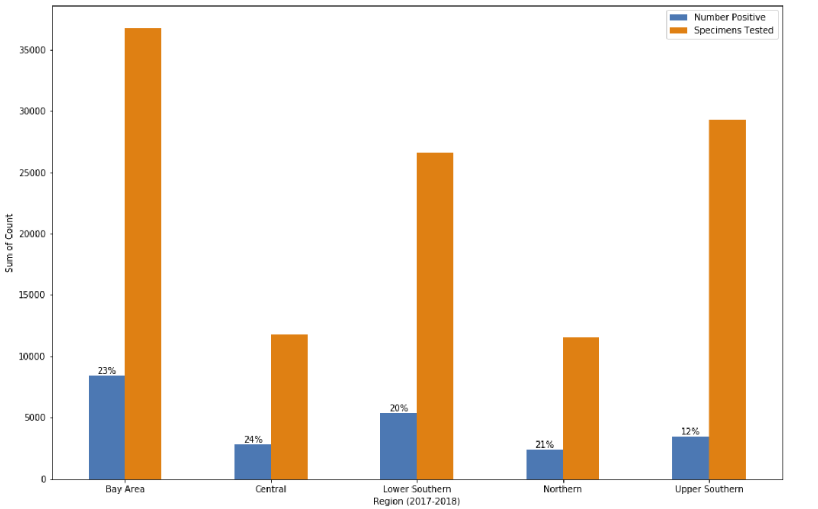
2016-2017
2017-2018
Notes:
Data also supports that there was an increase in specimens tested for flu and a resulting increase in cases of positive flu test results during the 2017-18 flu season compared to previous years at the regional level.
We can conclude that since we have a decrease in vaccination rates for the 2018-2019 flu season, we can expect an increase in the number of positive flu tests.

Slide 18
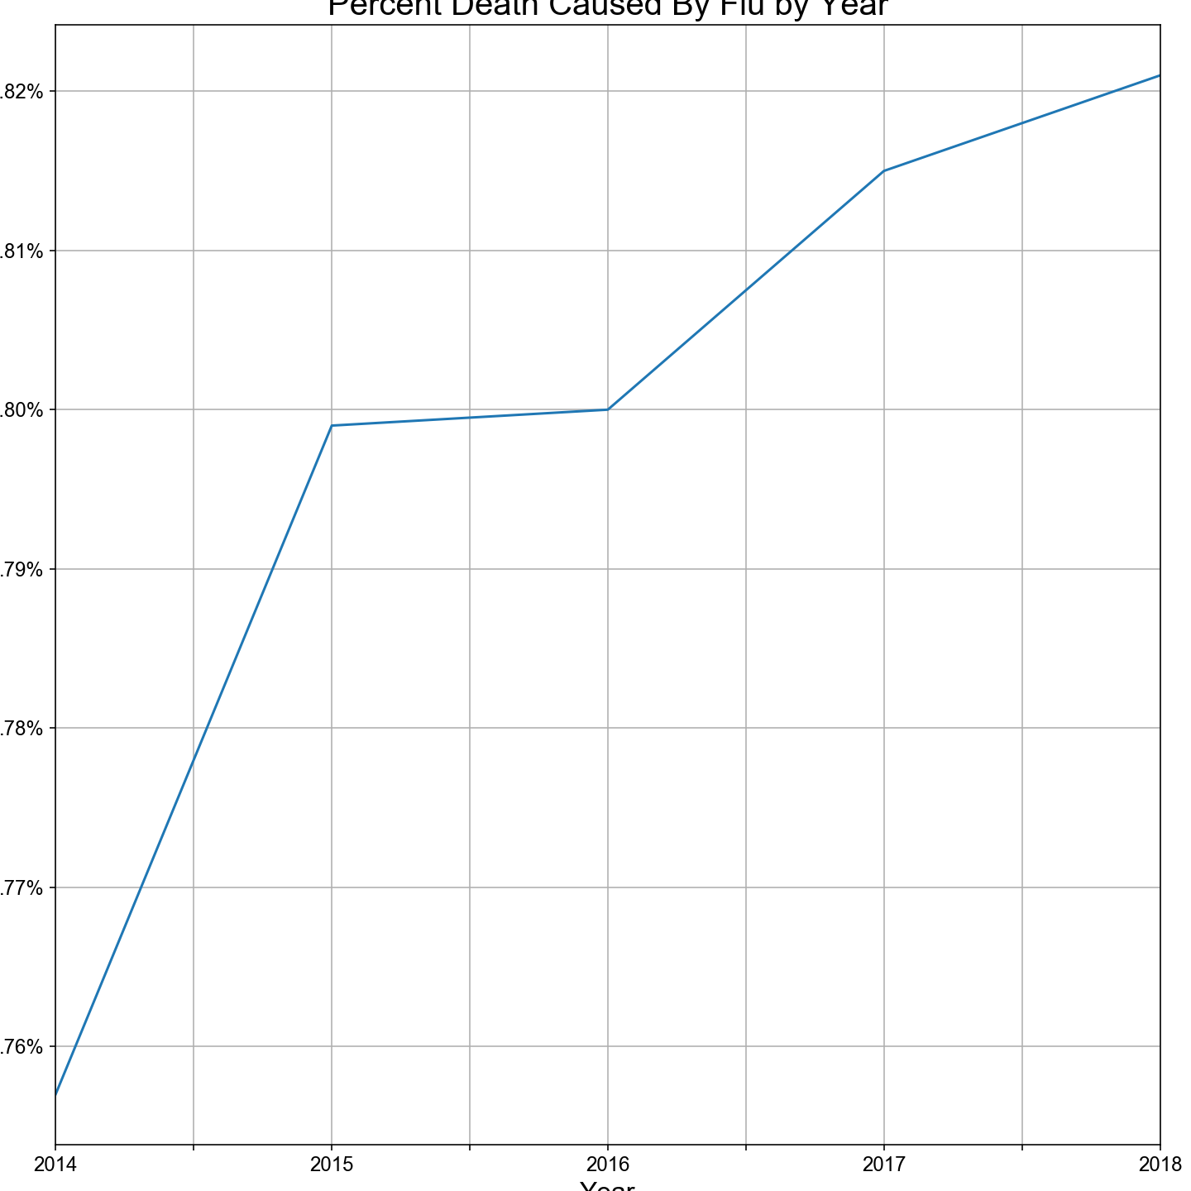
MORTALITY BY YEAR
Percent Death Caused by Flu - Yearly
Death Rate
Year

Slide 19
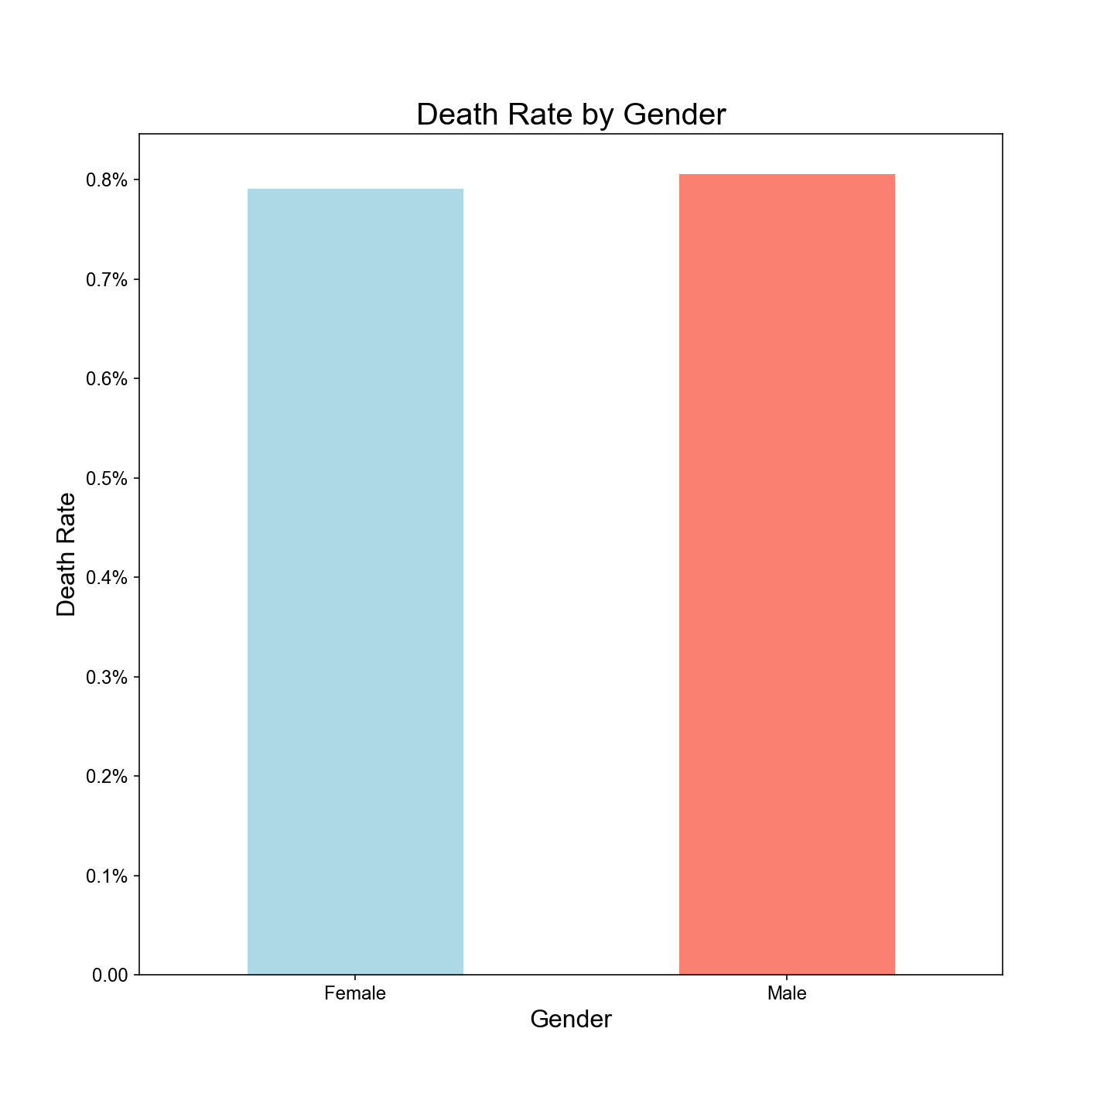
MORTALITY BY GENDER
.791%
.806%

Slide 20
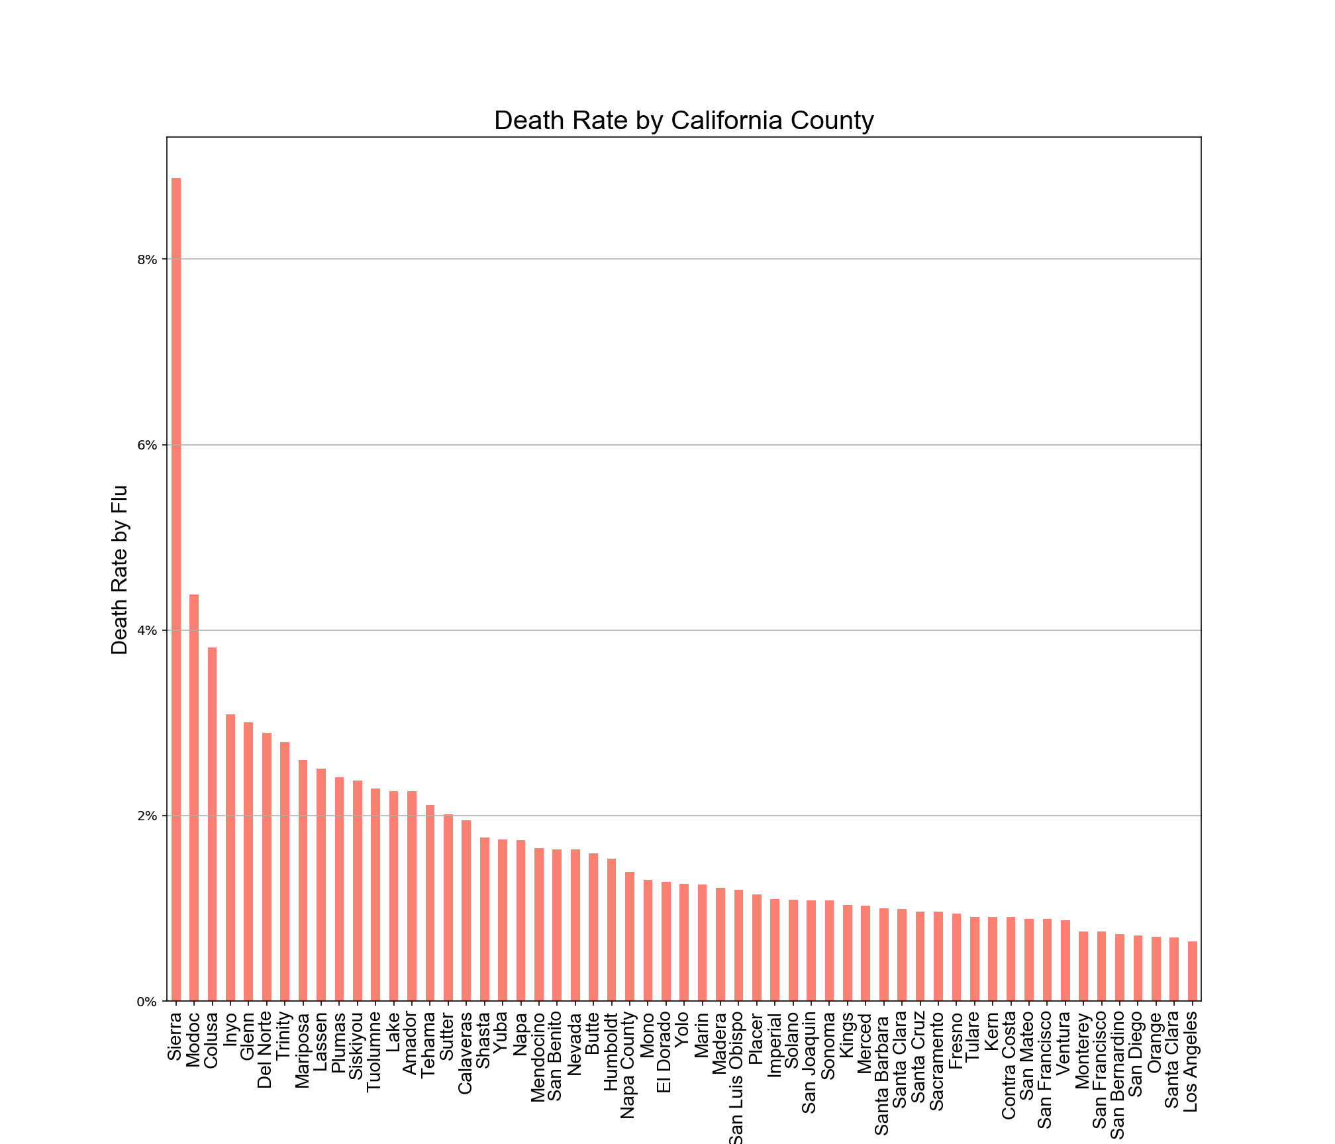
MORTALITY BY COUNTY
California Counties

Slide 21
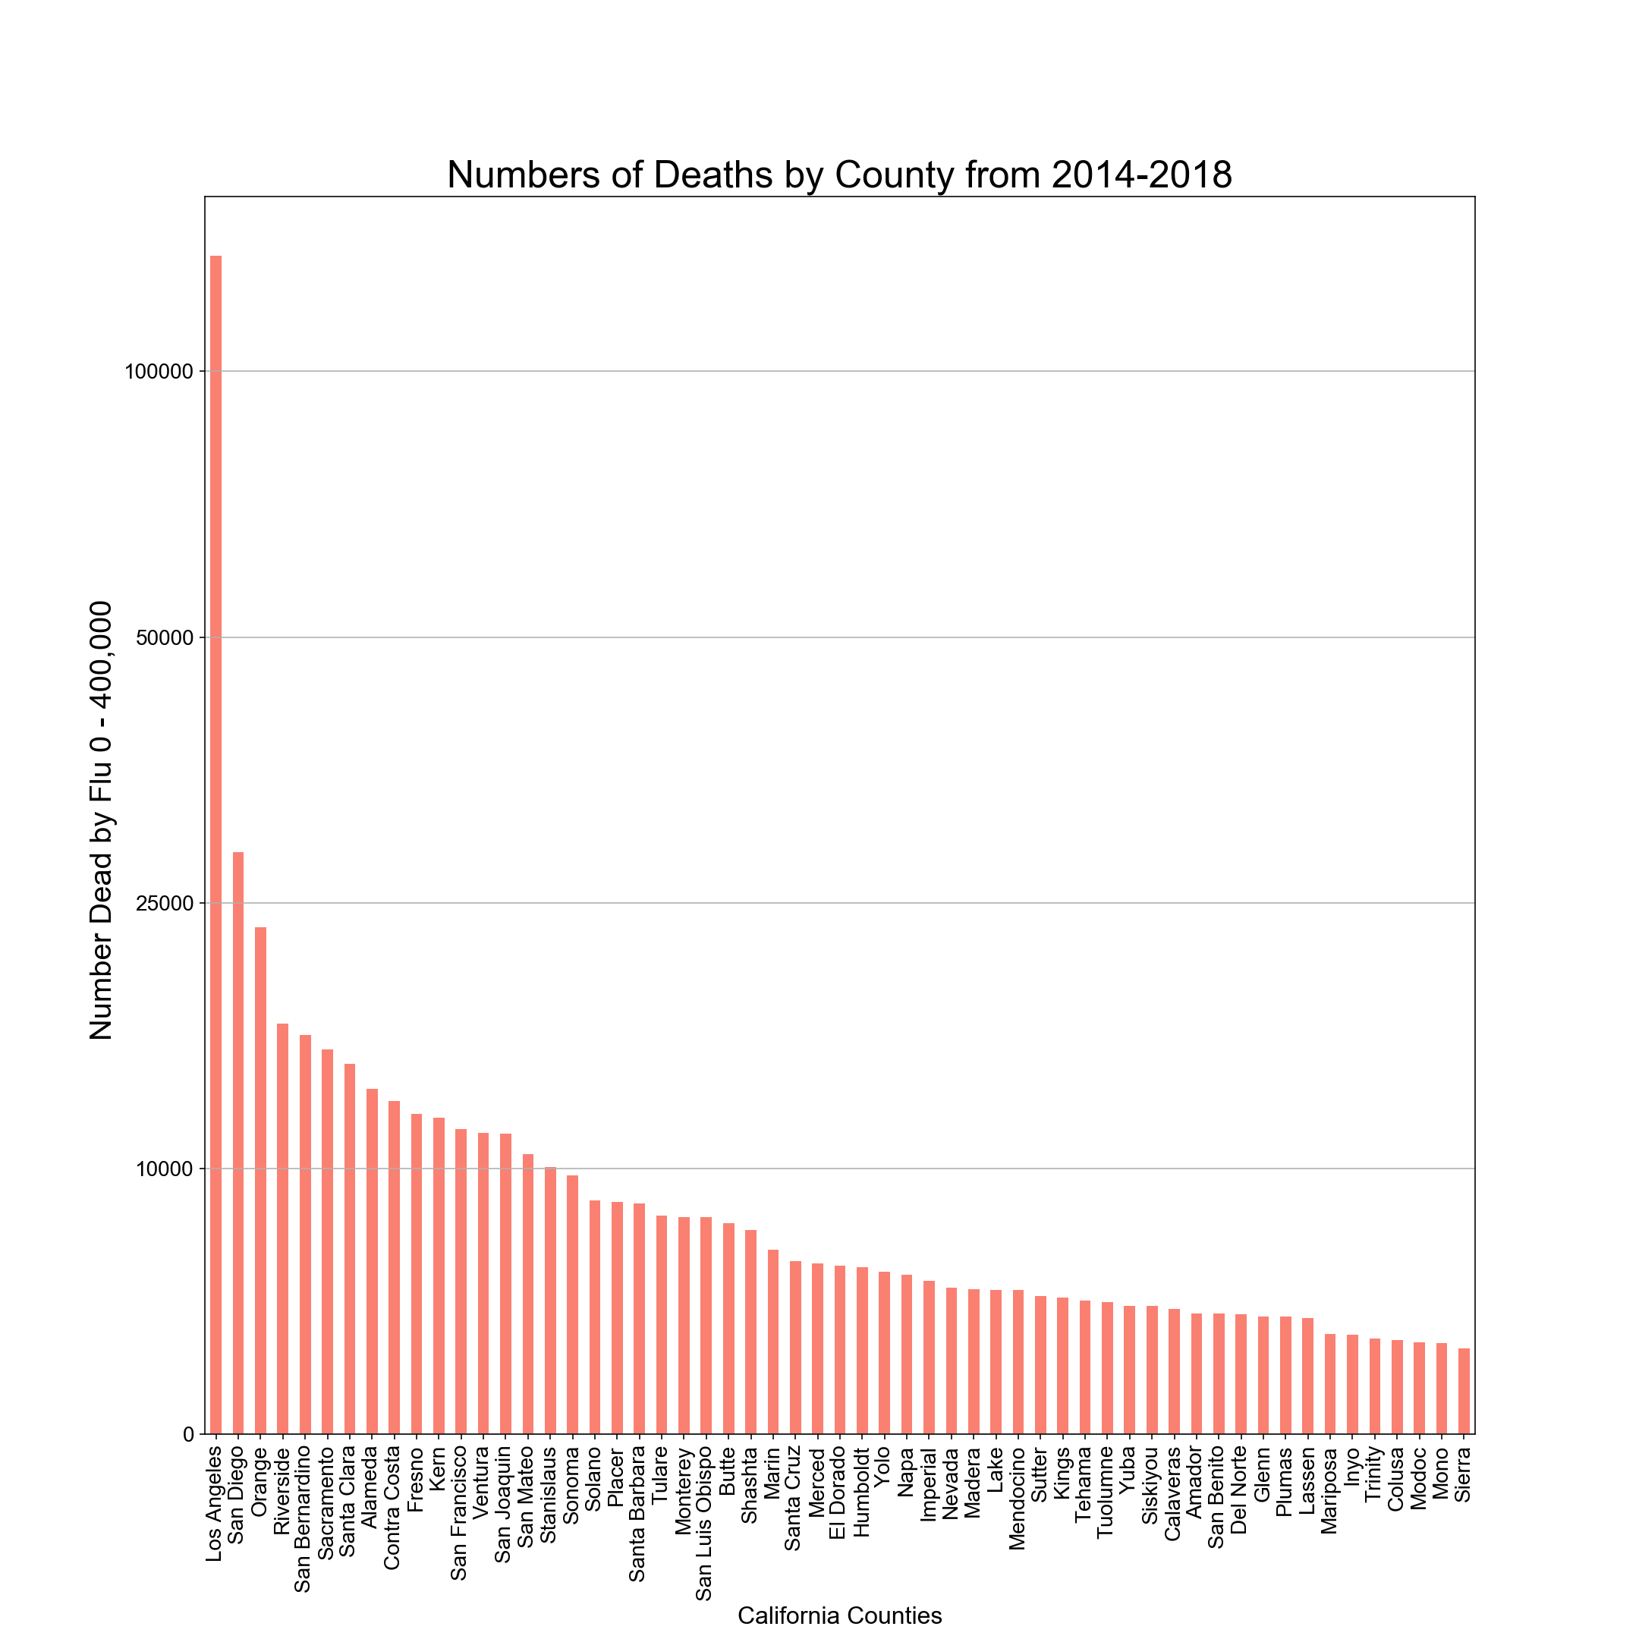
MORTALITY BY COUNTY

Slide 22
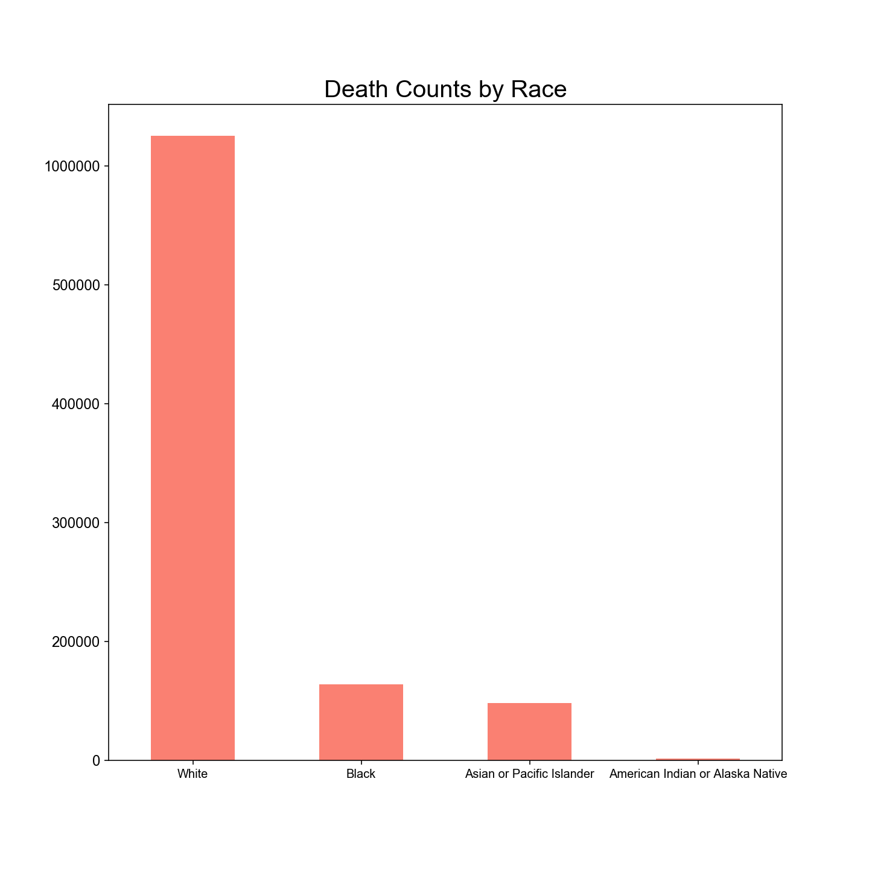
MORTALITY BY RACE

Slide 23
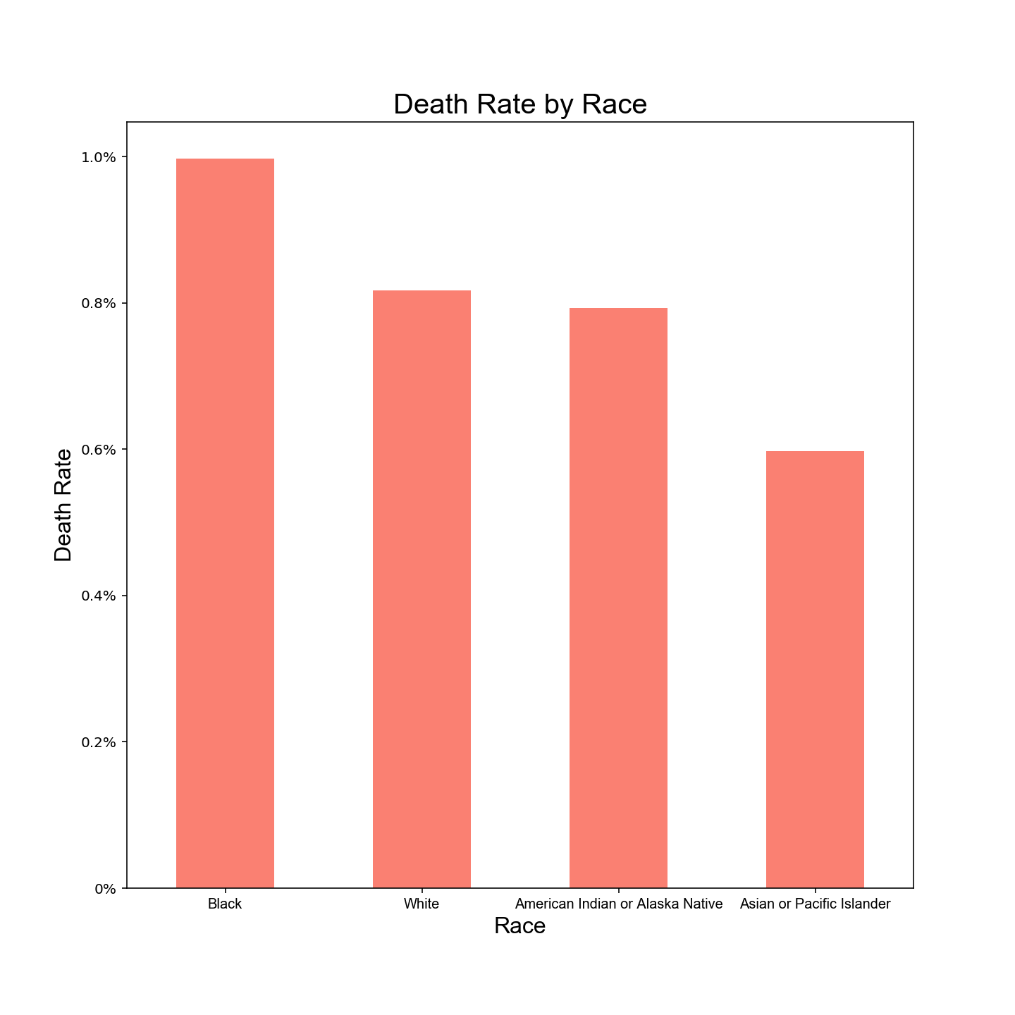
MORTALITY BY RACE

Slide 24
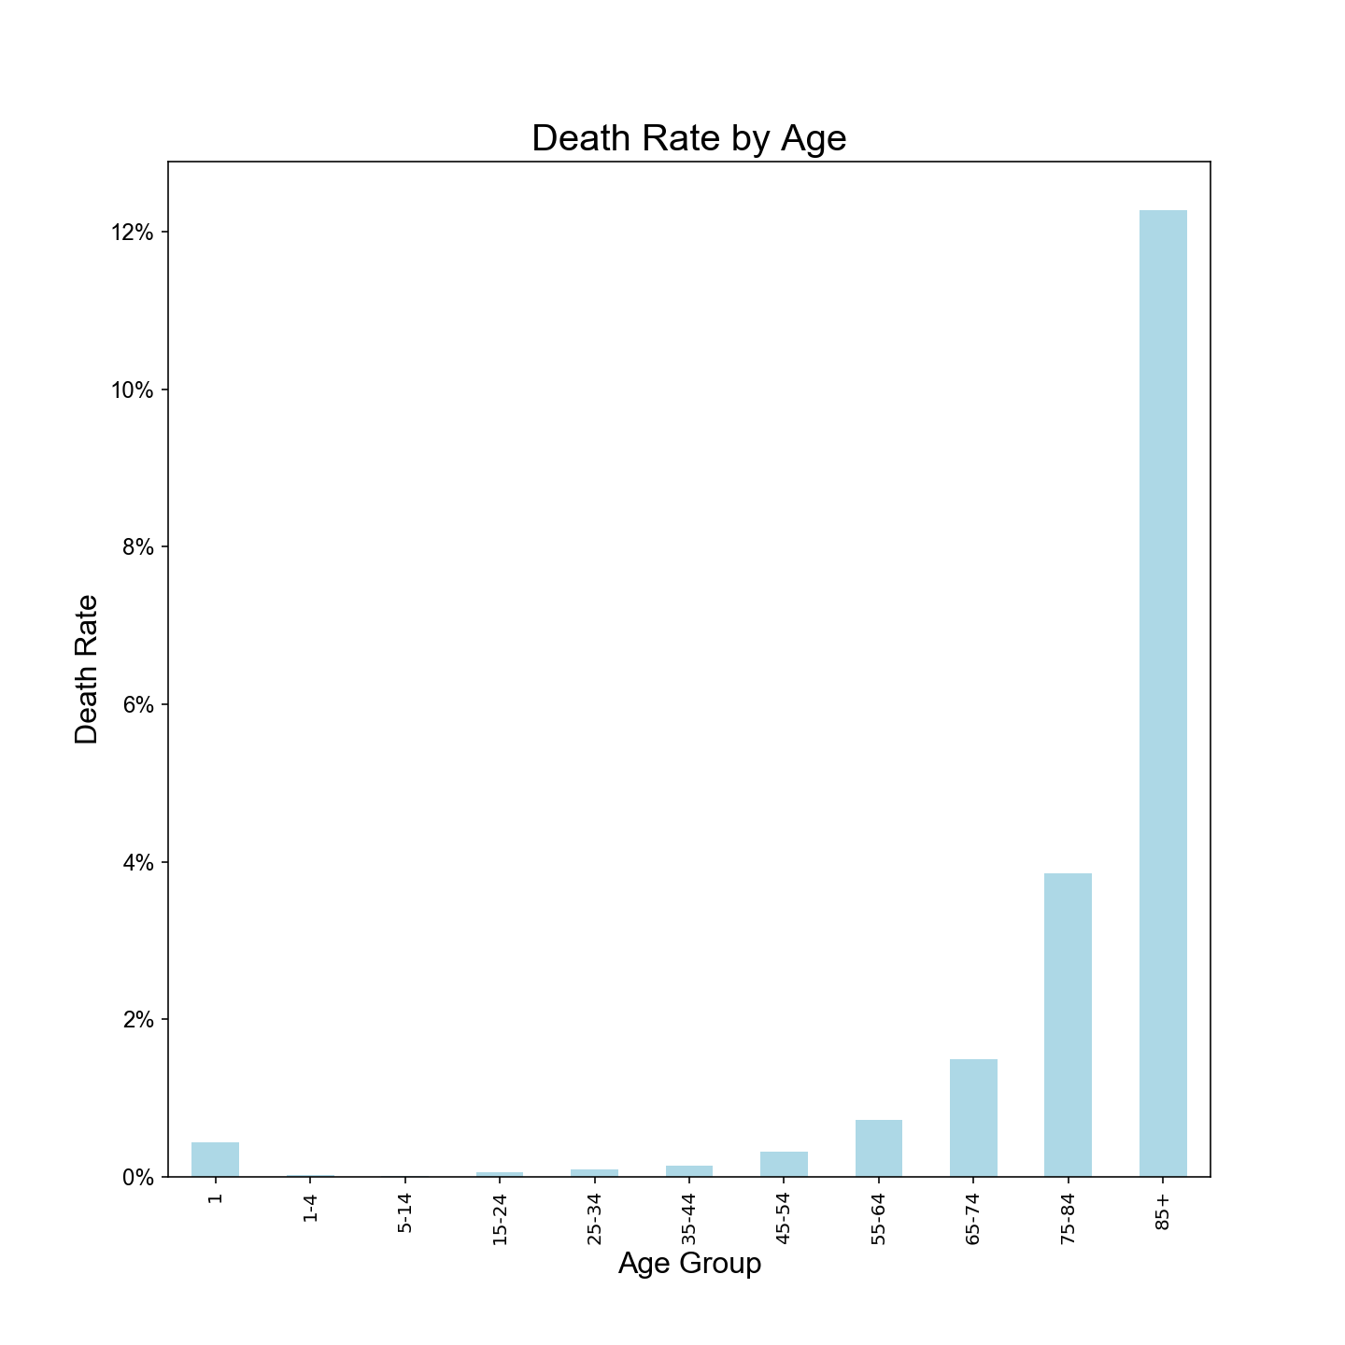
MORTALITY BY AGE

Slide 25
RECOMMENDATIONS
RECOMMENDATION 1
Start Flu Vaccination Campaign in late summer - early fall (July - September)
RECOMMENDATION 2
Target Southern California (Los Angeles,, San Diego, Orange, San Bernardino)
RECOMMENDATION 3
Although everyone needs to be vaccinated more, this campaign will focus more on: Black and White communities
And Ages 18-49

Slide 26




QUESTIONS ?
Notes:
Morbidity data shows a connection between morbidity rates and vaccination rates,: Lower the vaccination rates then greater the morbidity rates.
For example, there was a large drop off of vaccination rates in California for the 2017-18 flu season. California experienced a significant increase in morbidity rates during the 2017-18 flu season compared to previous years

Slide 27
THANK YOU FOR LISTENING
Now go get the flu shot...
Notes:
Morbidity data shows a connection between morbidity rates and vaccination rates,: Lower the vaccination rates then greater the morbidity rates.
For example, there was a large drop off of vaccination rates in California for the 2017-18 flu season. California experienced a significant increase in morbidity rates during the 2017-18 flu season compared to previous years

Slide 28
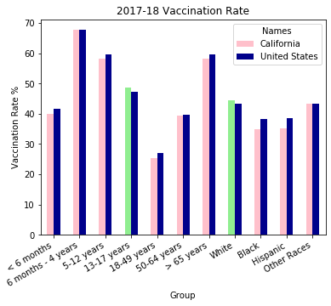
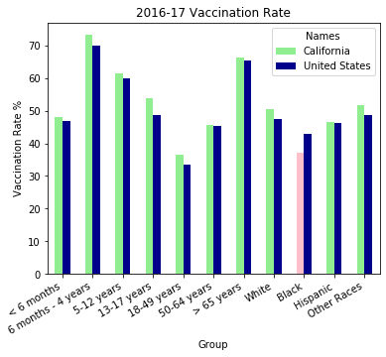
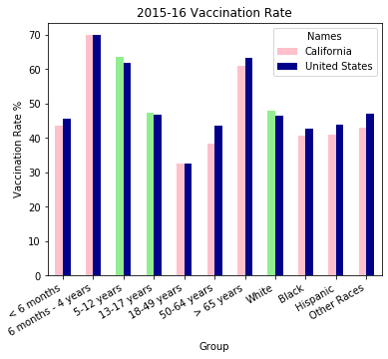
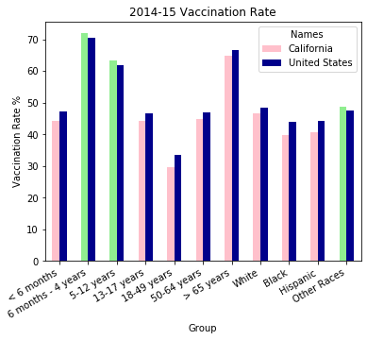
APPENDIX

